Slide 1
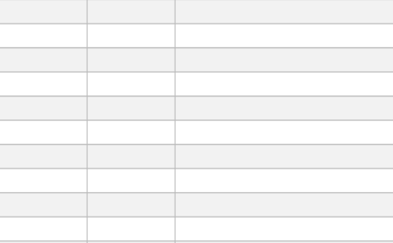
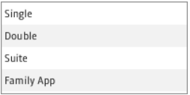
Choice Box
Table view control
File
Literature
Corpus
Free text
Text Filed control
List View control

